Slide 1
I2C MASTER SLAVE COMMUNICATION USING VERILOG
Sakshi k v
Samruddhi s kage
Sanjana veerangoudar
Shrinidhi Angadi
Under the guidance of
Prof. sunil mathad

Slide 2
Communication Protocols

Slide 3
 | UART | CAN | USB | SPI | I2C
PROS | Well known simple | Secure fast | Secure ,fast, plug and play | Fast, low cost, universally accepted, large portfolio | Simple, plug and play, cost efficient, universally accepted
CONS | Limited, functionally, point to point | Complex, limited portfolio, automotive oriented | Powerful master required, no plug and play software, extra drivers required | No plug and play hardware, no fixed standard | Limited no. of components due to capacitance effect
Comparison of different protocols [3]

Slide 4
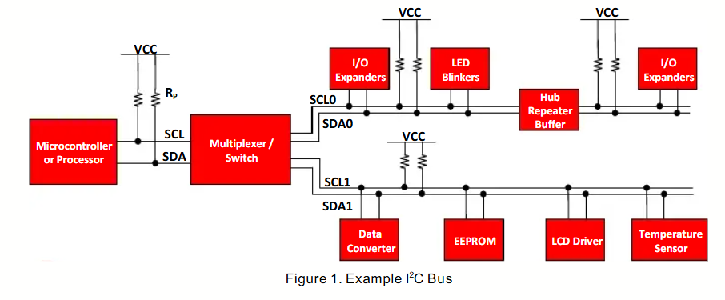
I2C COMMUNICATION PROTOCOL
Typical- 5v
1k ohm – 10k ohm
[5]
Normally speed of device is 400kbps

Slide 5
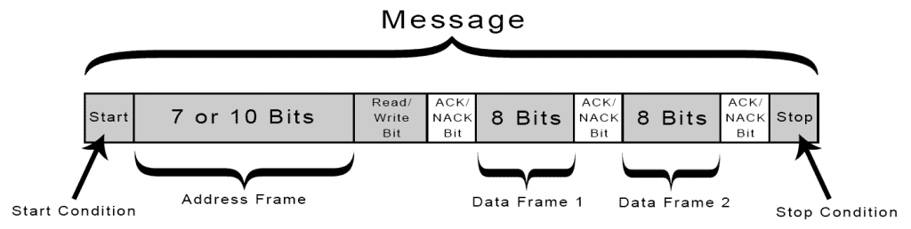
Byte Diagram
How I2C Works [6]

Slide 6
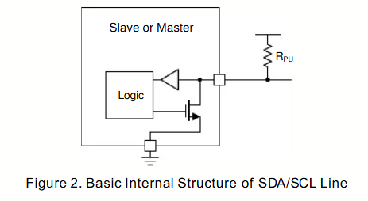
[5]

Slide 7
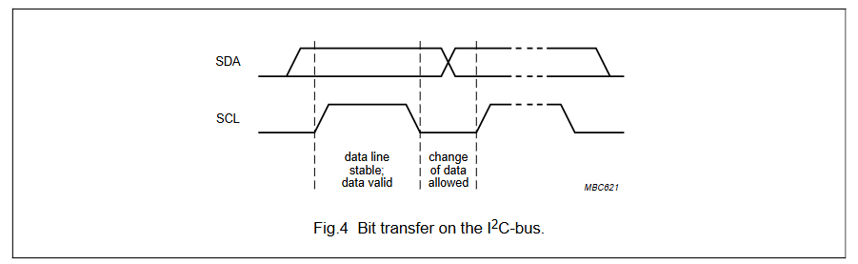
[5]

Slide 8
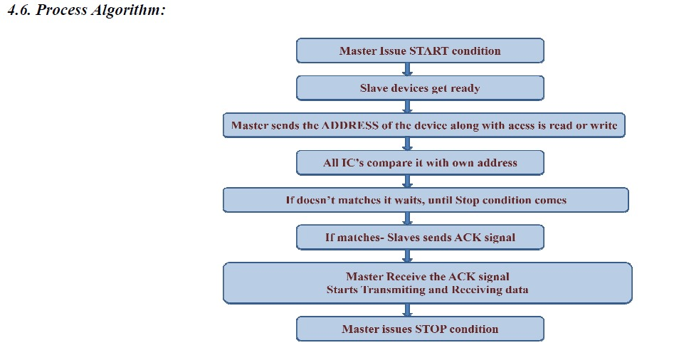
Process Algorithm
[3]

Slide 9
I²C Arbitration and Clock Synchronization
Introduction to I²C Arbitration.
Arbitration Mechanism.
Arbitration occurs on the SDA line while the *SCL line* is high.
Each master monitors the SDA line and compares the sent and actual data on the bus.
If a master sends a HIGH but reads a LOW, it loses arbitration and stops transmitting.
Arbitration continues bit-by-bit until one master remains (the winner).
This process ensures no data loss because the winning master continues its transmission seamlessly.
Clock Synchronization.

Slide 10
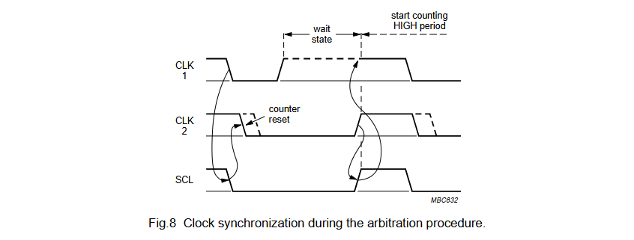
[3]

Slide 11
I2C Using Verilog
Block Diagram:
I2C Master
SLAVE
Memory
Memory

Slide 12
Master:
CLK Divider
FSM
Start and Stop condition generator

Slide 13
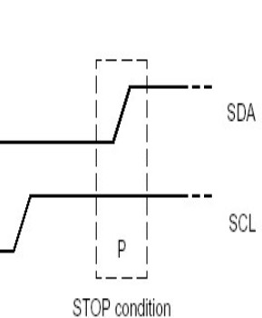
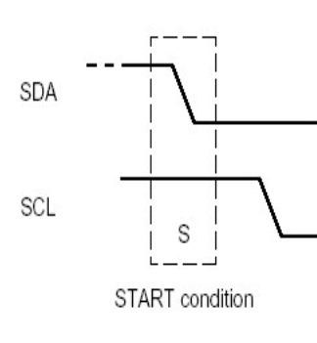

Slide 14
State Diagram:
Fig [4]

Slide 15
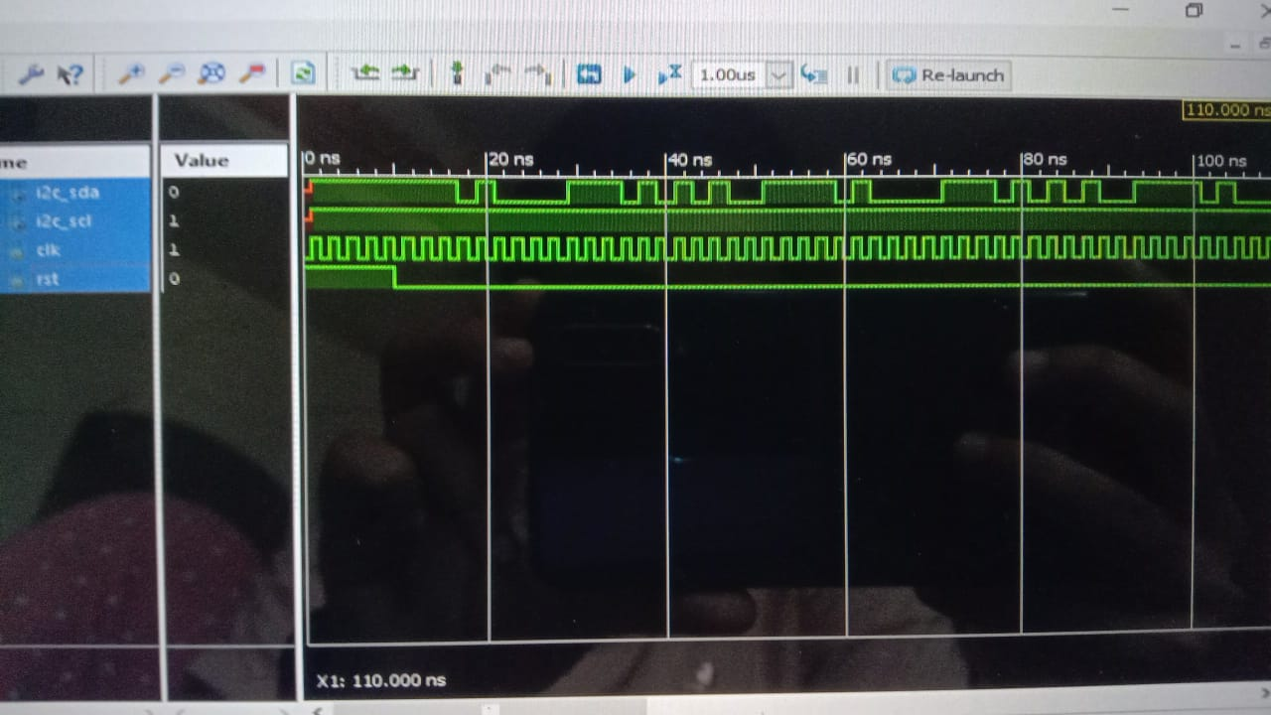

Slide 16
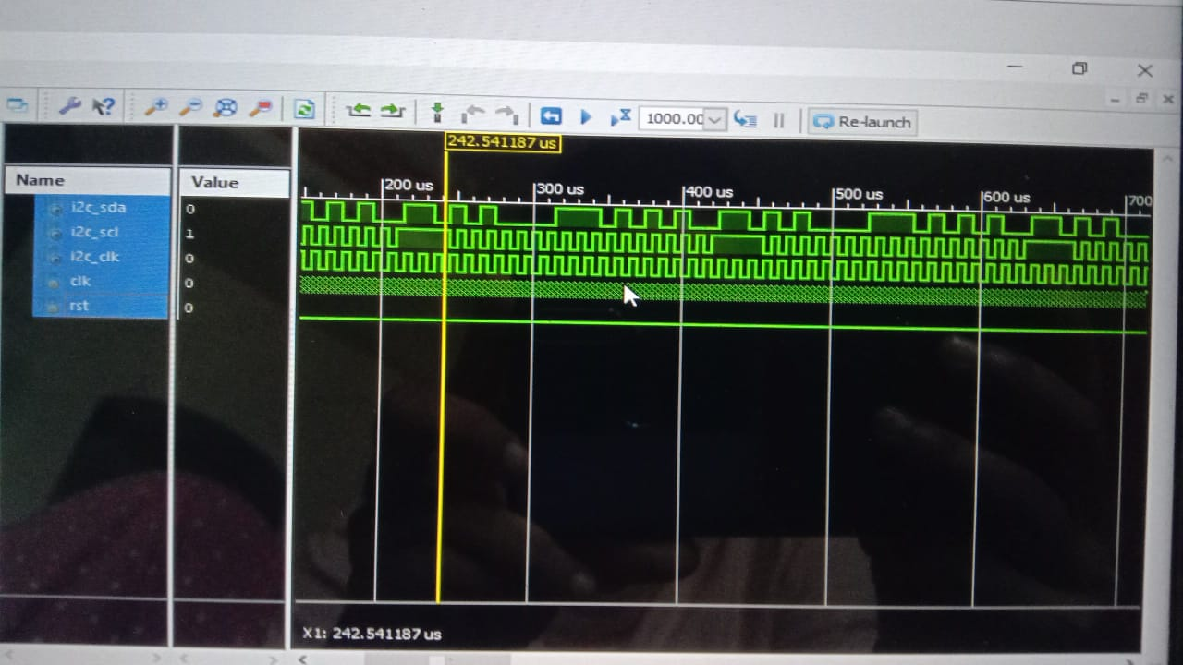

Slide 17
References:
[1] EVALUATION OF I2C COMMUNICATION PROTOCOL IN DEVELOPMENT OF MODULAR CONTROLLER BOARDS Alvin Jacob, Wan Nurshazwani Wan Zakaria, and Mohd Razali Bin Md Tomari, Advanced Mechatronics Research Group, Faculty of Electrical & Electronic Engineering, University Tun Hussein Onn Malaysia, Parit Raja, Batu Pahat, Johor, Malaysia.
[2] FSM implementation of I2C protocol and its verification using Verilog Tapaswi SJ1, Dr Kiran V2.
[3] Volume 2, Issue 1, January 2014 International Journal of Research in Advent Technology, Available Online at: http://www.ijrat.org
[4] I2C BUS PROTOCOL USING VERILOG 2019 JETIR June 2019, Volume 6, Issue 6
[5] Texas Instrumentation, “Understanding I2C Bus”, June 2015.
[6] https://www.circuitbasics.com/basics-of-the-i2c-communication-protocol

